Slide 1
CMPS 280 Final Project
Blue Dragons

Slide 2
DESCRIPTION OF THE BUSINESS
This software will allow our business –St. Ann Wine Bar to easily track employee/employer data and performance.
Business operations:
Track employee information
Provide quality costumer service to costumers
Business data:
data used from accounting book

Slide 3
Software Requirements
Functionalities expected in the software:
The software will track individual employee and overall data including:
Individual and total for employees
1. Tips 5. If the sales goal was met.
2. Sales 6. Costumer Happiness (based on an 18 percent tip)
3. Hours worked
4. Profit
j

Slide 4
CLASS DEFINITIONS

Slide 5
Class Lists
Regular Classes
Business
Employee
Employer
Abstract Class
Person
Interface
IEmployeePerformance
Exception Class
InvaldInputException
z

Slide 6
Business(Main)
Purpose: Main Class
UML Diagram
z

Slide 7
Person(Parent)
Purpose: Hold the constructor and methods for name and job description since all classes share that property. Also, hold the (abstract protected void getPayRate();) method for employee and employer to implement.
z

Slide 8
Employee(Child)
Purpose: To keep track of
Individual data and job
performance for each employee.
j

Slide 9
Employer(Child)
Purpose: To keep track of overall data
and job performance for all employees.
j

Slide 10
IEmployeePerformance(Interface)
Purpose: Interface for both employee and employer to track jib performance and pay rate.
z

Slide 11
InvalidInputException(Exception Class)
Purpose: personalize exception messages to be used when needed for custom exceptions
UML Diagram
j

Slide 12
SPEACIAL REQUIREMENTS

Slide 13
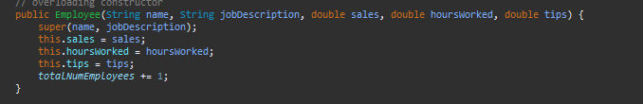



Static Class Members
Purpose: to be used in a method that adds one every time an employee object is created
Purpose: to be used in a method that adds one every time an employer object is created
j

Slide 14

Use of ArrayList
Purpose: To have a list of Employee Objects.
Found in Employee Class
Purpose: To have a list of Employer Objects.
Found in Employer Class
z

Slide 15
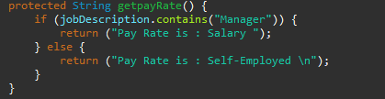
Use of Searching
Searched through array list of employer and employees to find what their job description in order to determine their payrate.
z

Slide 16

Use of Sorting
Sorted employer array list alphabetically. Since it is an array of objects we had to implement the comparator so the compiler can compare their names within the objects.
j

Slide 17
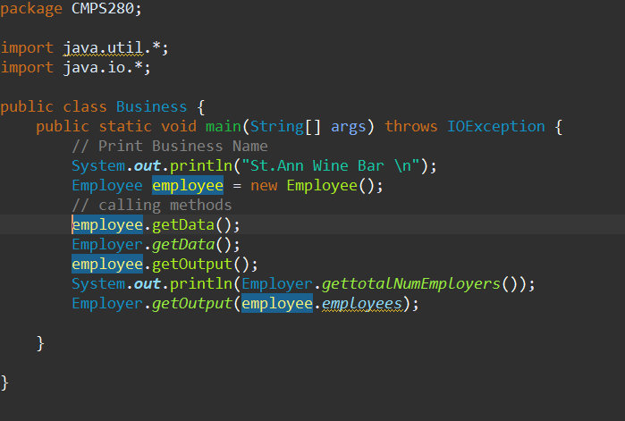
Business(Main)
j

Slide 18
Input Files

Slide 19
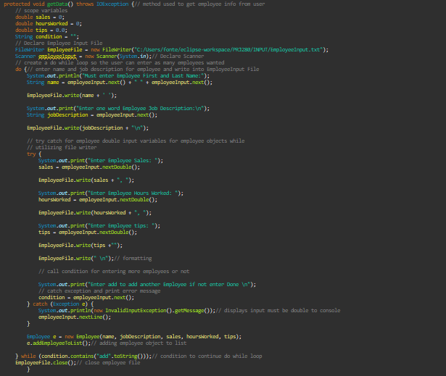
Employee Input File
j

Slide 20
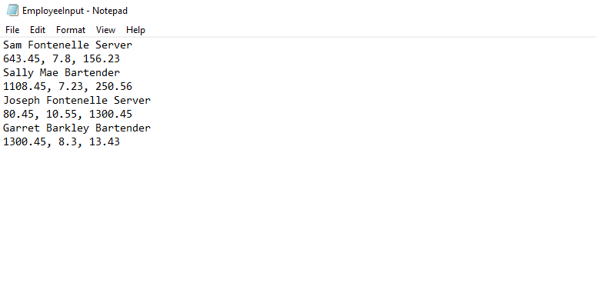
Employee Input File

Slide 21
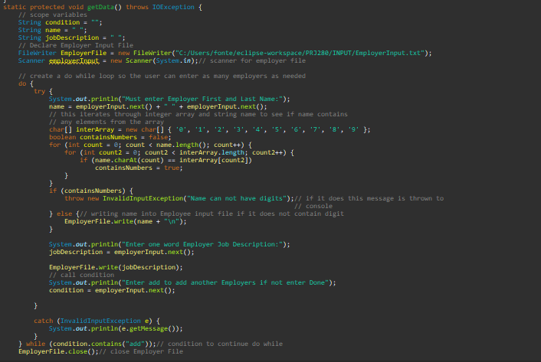
Employer Input File
j

Slide 22
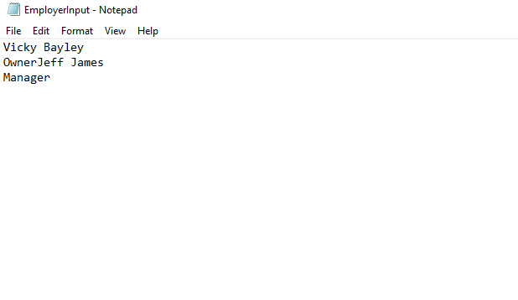
Employer Input File

Slide 23
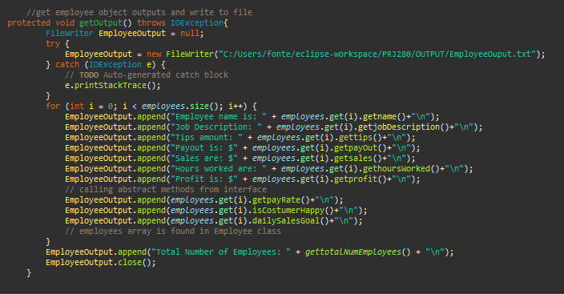
Employee OutPut File-prints individual employee objects
Z

Slide 24
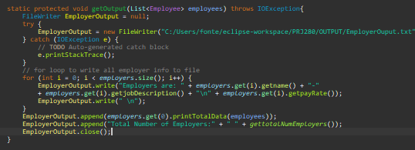
Employer Output File- prints total of employee objects and individual employer objects
J

Slide 25

Doc
j

Slide 26
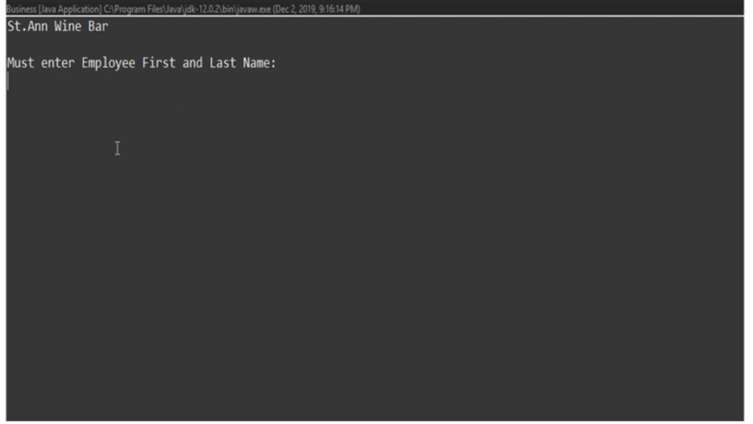
demo

Slide 27
Credits and References
Stackoverflow.com
Youtube.com
Tutor Lab

